Slide 1
Online Registration How-To

Slide 2
How To Create
Your Account
Go to https://secure.rec1.com/TX/keller-tx/catalog
Click “Create Your KPR Account”
If you’re a current member of The Keller Pointe or already have an account and need help logging in, please contact staff to reset password.
If you’re unsure if you’re a member, please call 817-743-4050 to verify membership.

Slide 3
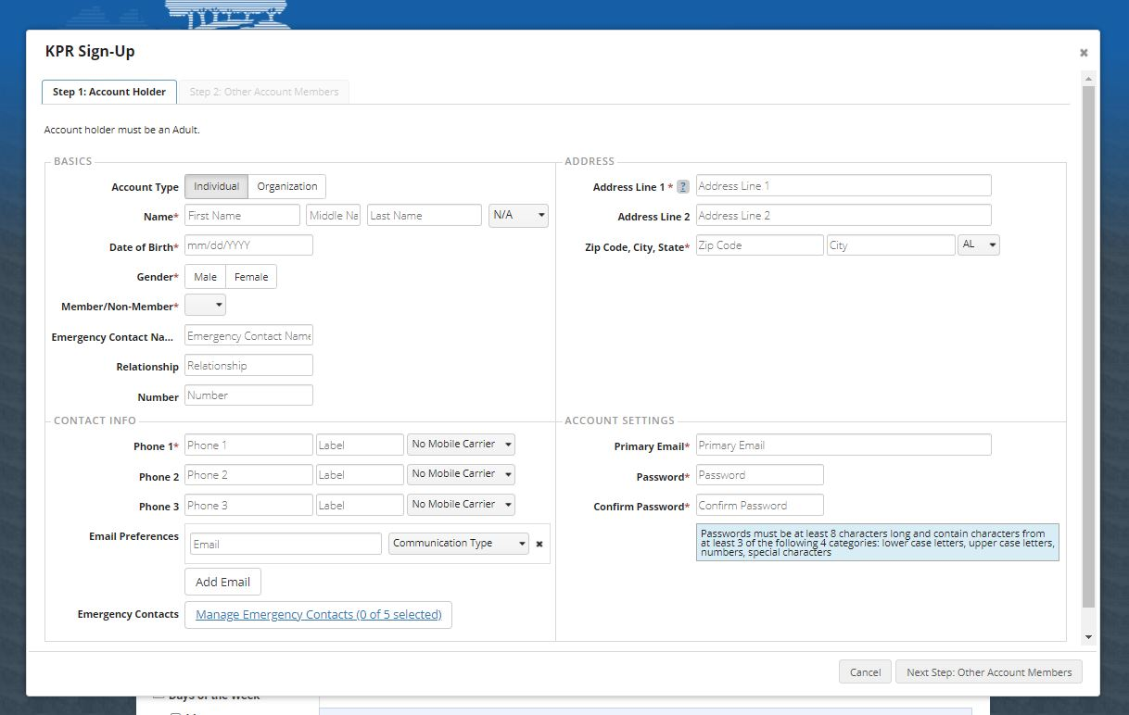
Input your information into the fields
You will select “Non-Member”. If you already have an account with The Keller Pointe this will all be filled in.
Please make sure you have a working e-mail address.
Please select all three communication types next to email preferences to receive updates.

Slide 4
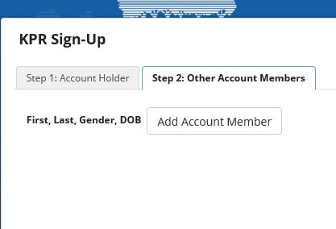
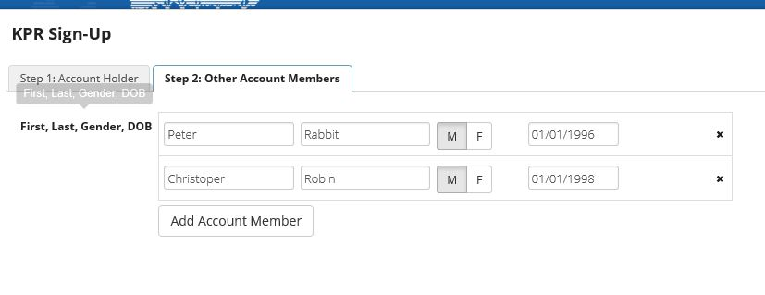
If you would like to add another member to the account, click “Step 2: Other Account Members” (others in your family including children). This plays a factor if they ever want to volunteer with us or sign-up for any camps.
Click “Add Account Member”
Input their information in the fields
Save & Close

Slide 5
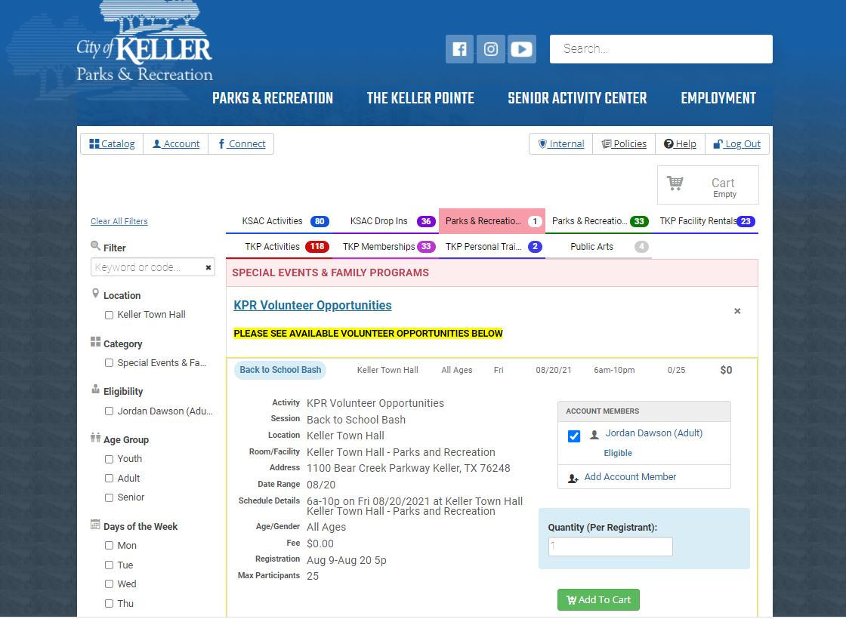
How To Register For An Activity
Click catalog in the top left hand corner.
Our tab is “Parks & Recreation Activities”
Then click on whichever tab you are wanting to sign-up for something.
All vendor opportunities will be listed under different categories (non-profit, merchant, commercial, and food). If you do not know what type of vendor you are, there are descriptions of each within the sign-up or you can call to check or verify.
All of our ticketed event will also be listed under this tab.

Slide 6
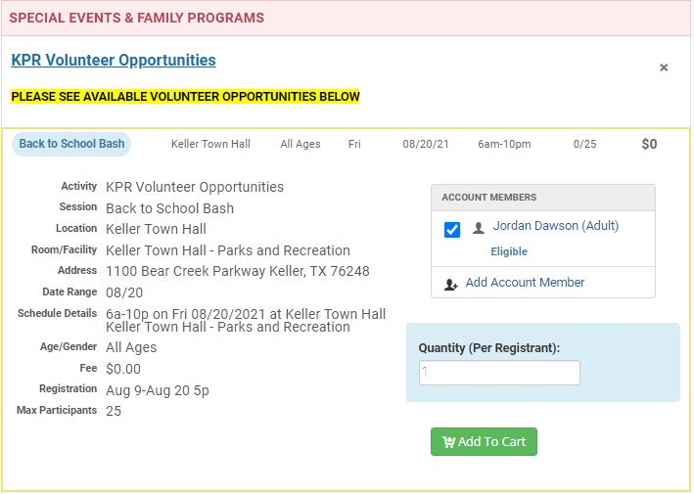
Activity
Information
How many people are registered for the activity and how many slots are open total.
Event name
Location
The date of the activity
Time slot for the event. Some events only have one time frame and some events have multiple time slots you can choose from.
When registration opens

Slide 7
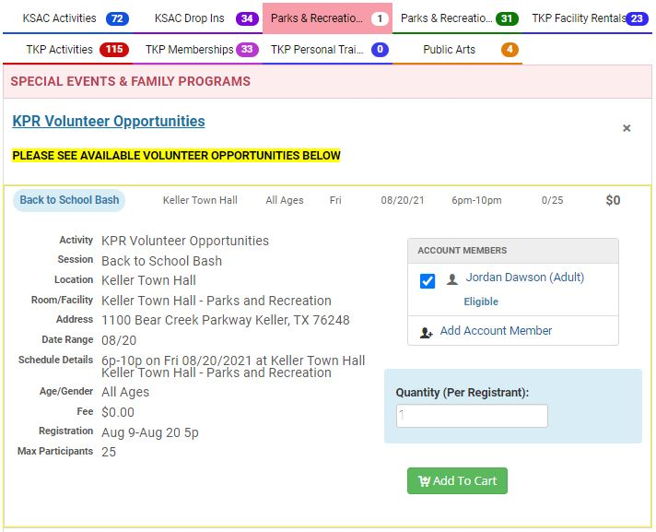
Select which user will be joining the activity
When you create your account and add family members, their name will appear under the account holders name. You will be able to select everyone in your family that will be participating.
Then click “Add To Cart”
The software system will not allow you to register or add to cart if any of the following apply to you:
Do not have an account created.
Registration has not opened.
Registration is closed.
Registration is full.

Slide 8
Once you are satisfied with the items that have been added to the cart, proceed with “Checkout” by clicking on the cart in the top right hand corner.
There you will see what you have selected and the amount that will be due at time of checkout.
Proceed to the bottom and click the blue checkout button.

Slide 9
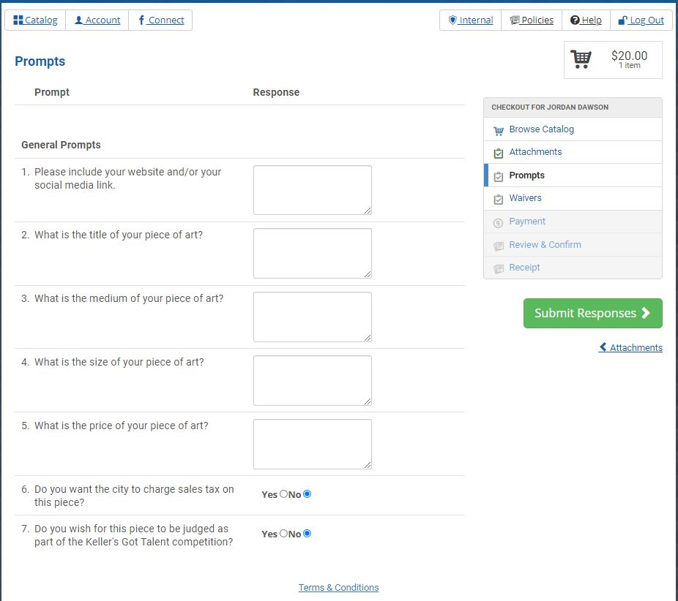
You will then be taken to the prompt page (if applicable). Not all events will have prompts for you to answer so if there are not prompts, you will instead be taken to the waiver page.
It is important you fill in or answer all the questions on this page or it will not allow you continue with the checkout process.
Once you have completed the prompts you will click on the green submit responses button.

Slide 10
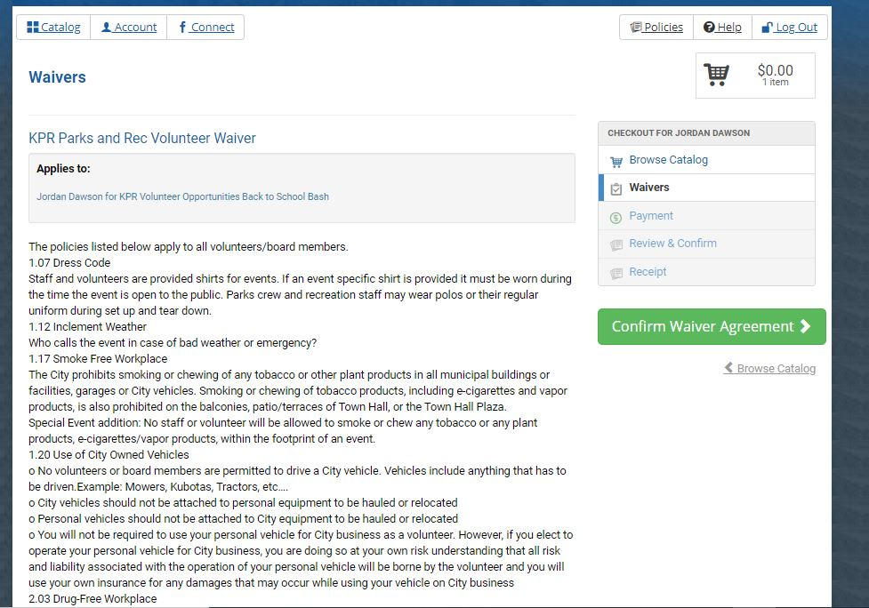
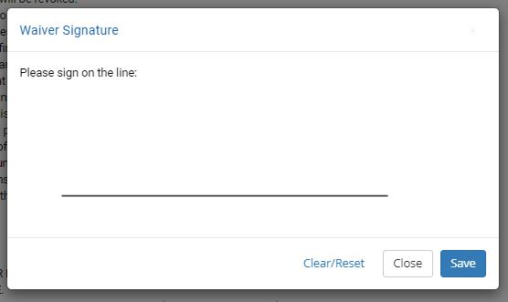
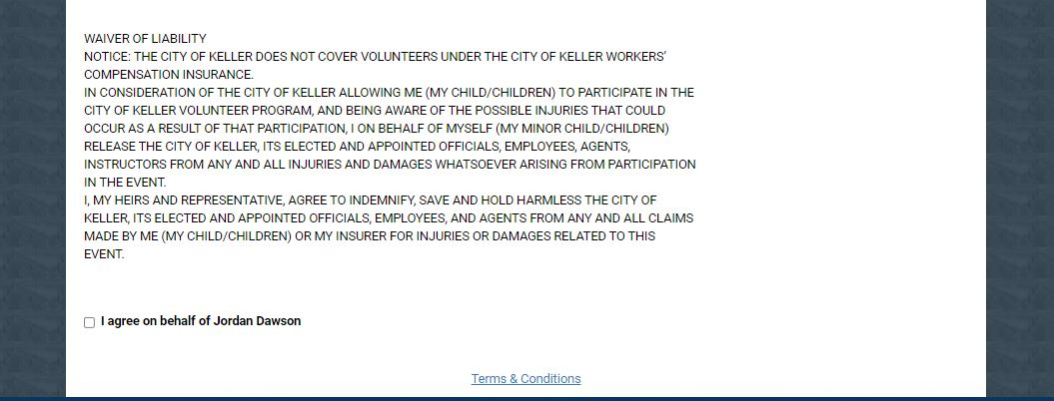
You will then be brought to the waivers page. Please read and sign all waivers on this page. You will not be able to continue with checkout if all waivers are not signed.
To sign the waiver, scroll to the bottom of the page and select the box next to “I agree on behalf of…”
Once that is clicked, a “waiver signature” box will appear and you will sign (with your finger or mouse) on the line and then click save.
Once waivers are signed, click the green “confirm waiver agreement” button.
Some waiver you only have to sign once, so if you have already signed it in the past you can click the green “confirm waiver agreement” button to continue.

Slide 11
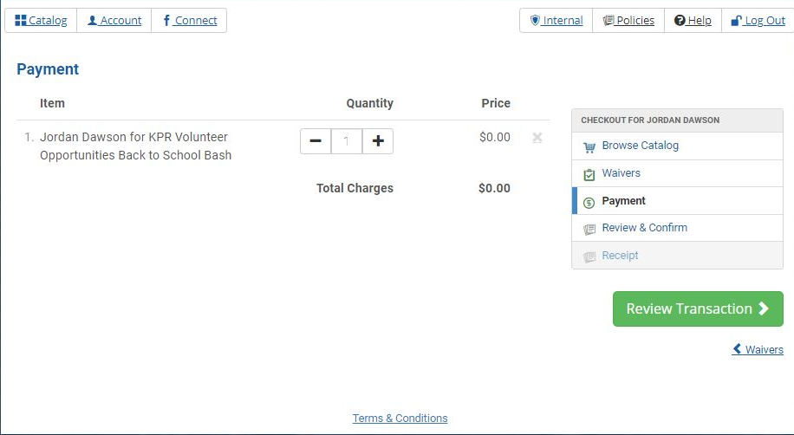
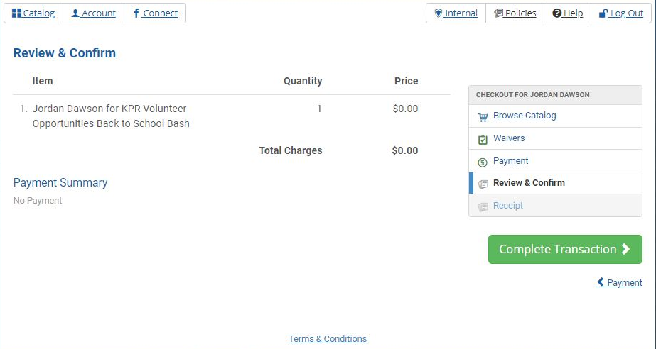
Once you reach this page you will just review to make sure you (and anyone else you are registering) is listed here for the correct events.
If correct click “review transaction”
Next click “complete transaction”
A receipt will be e-mailed to you. If you need to search for your receipt to see what you signed up for the email comes from City of Keller, TX (noreply@rec1.com)
You can also see all your “transactions” (anything you have signed up for) by logging in, pressing the account button on the top left hand corner, and then click on transaction history.

Slide 12
Questions?
Contact us at
817-743-4050
parksandrec@cityofkeller.com

